Slide 1
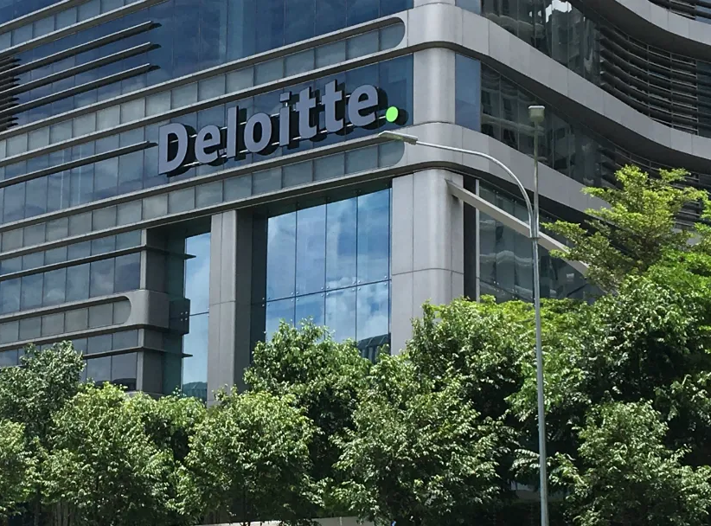
ReLeaf the Earth
Urban Tree Planting Analysis

Slide 2
We know very little about our trees
There is gap for data driven solutions to monitor and plan urban trees in Malaysia

Slide 3


Let’s revisit the benefits of trees
Known ecological benefits
Stormwater Interception
Air Pollution Removal
Energy Conservation
Carbon Dioxide Storage

Slide 4
Why this analysis is important
City councils to leverage on data-backed advice to improve
air quality
flood alleviation
a more walkable city
Road disaster prevention
pre-emptive measures for falling trees
pedestrian safety
Balanced cities
greenery reduces stress
rising trend of forest bathing

Slide 5
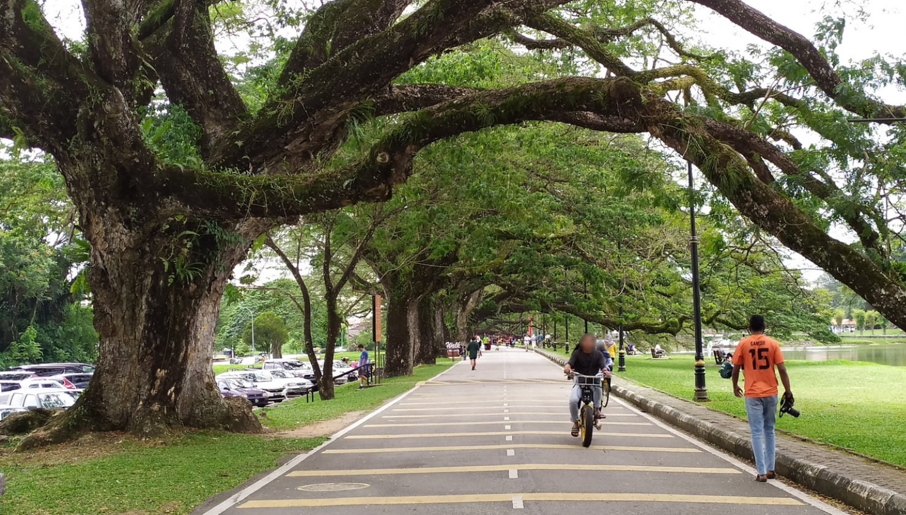
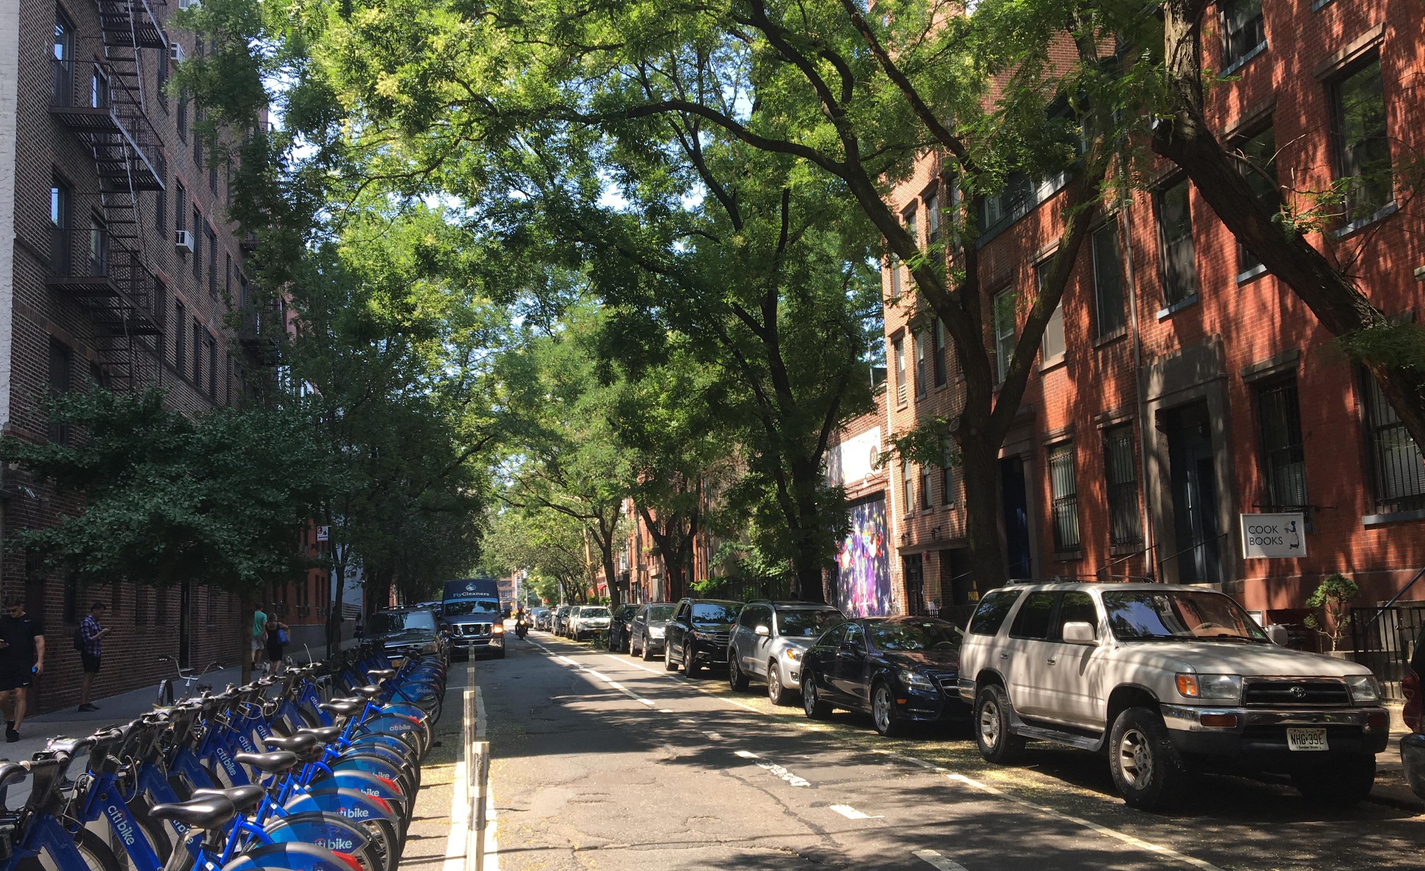
Specialized tools
Satellite imagery and street view as basis for urban tree planning
Gemini Vision 2.0 to analyze street view imagery, detect existing trees, surrounding and obstacles
Extensible - Connecting data points such as traffic (Maps API) and weather (Weather API)
Location search → aerial analysis → ground vision → species recommendation

Slide 6
The Problem (Market Gap)
🚨 The Data Gap Crisis
$2B SEA carbon market – but no one can measure impact
58% of executives lack reliable climate data (Deloitte 2024 CxO Report)
60% can't measure if sustainability investments work
Result: Millions spent on hope, not strategy
Notes:
"Let's start with a number: $2 billion. That's the Southeast Asian carbon offset market, growing 30% annually.
But here's the crisis hiding behind that number: According to Deloitte's own 2024 CxO Sustainability Report—which surveyed over 2,100 executives—58% cite lack of reliable data as their number one barrier to climate action. Another 60% struggle to measure if their sustainability investments actually work.
Translation? Corporations are spending millions. Governments are launching initiatives. But nobody can prove what's working. That's not strategy. That's expensive hope. And hope doesn't prevent disasters."

Slide 7
The Solution - Dual Market Value
💰 Two Revenue Opportunities
Government (B2G):
Problem: RM1B lost annually to urban floods
Solution: AI identifies optimal tree placement for flood prevention
Outcome: "Reduced flood risk by 15%" ← Measurable, accountable
Corporate (B2B):
Problem: ESG reports lack credible impact data
Solution: Verified metrics (carbon reduction, urban cooling, flood protection)
Outcome: Competitive advantage in ESG compliance
Notes:
"ReLeaf solves this by creating measurable value for two critical markets:
First, governments. Malaysia loses RM1 billion every year to urban flooding. Not over decades—every single year. Now imagine city councils using AI to identify exactly where trees create maximum flood interception. Not beautification. Strategic disaster prevention. Suddenly they can say: 'We reduced flood risk by 15%, protected 50,000 residents, saved RM50 million in damages.' That's accountability. That's data-driven governance.
Second, corporations. Every Fortune 500 company in Southeast Asia needs ESG metrics. But their reports say 'We planted 10,000 trees'—with zero impact data. ReLeaf changes that: 'Our trees sequestered X tons of carbon, reduced temperatures by Y degrees, protected Z residents from floods.' That's not just compliance. That's competitive advantage. That's the difference between greenwashing and genuine climate leadership."

Slide 8
Why Deloitte Wins
🎯 Deloitte's Unfair Advantage
✓ Existing trust – Already advise on ESG & sustainability
✓ Established relationships – Government & corporate clients
✓ Brand credibility – Big 4 reputation beats startup pitches
✓ Speed to market – Product extension, not new market entry
Result: While competitors build trust, Deloitte deploys immediately
Notes:
"Now here's why this is specifically a Deloitte opportunity:
Deloitte already operates in sustainability consulting. You already advise governments on smart cities. You already counsel corporations on ESG strategy. You have the relationships. You have the brand credibility. You have the trust that takes competitors five years to build.
ReLeaf isn't a new market requiring client acquisition—it's a product extension that strengthens what you already do. Think about it: While startups are cold-calling and pitching proof-of-concepts, Deloitte walks into an existing client meeting and says, 'Your ESG strategy can now include AI-driven impact verification.' That's not a sales pitch. That's a value-add.
That's the unfair advantage. While others build credibility, Deloitte deploys. That's not market entry—that's market definition."

Slide 9
The Opportunity
🚀 Market Positioning
200+ Malaysian cities need this solution
Southeast Asia: Thousands of urban centers facing same challenges
Climate tech exploding: First mover captures market leadership
Bottom Line: Deloitte doesn't just participate — You define the standard
Notes:
"Let's talk scale. Malaysia has over 200 cities that need this right now. Southeast Asia? Thousands of urban centers facing identical challenges—flooding, heat islands, pressure to demonstrate climate action.
But this isn't just about tree planting. This is about positioning Deloitte at the intersection of three exploding markets: climate tech, ESG compliance, and smart city infrastructure. That's a multi-billion ringgit opportunity.
Here's what I see: In 12 months, a city announces they reduced flood risk by 20% using Deloitte's platform. National news. Other cities line up. In 24 months, a Fortune 500 publishes verified impact metrics from Deloitte. Their competitors panic. In 36 months, when people think 'climate action in Southeast Asia,' they think Deloitte.
That's not a pitch. That's a roadmap.“
Closing
ReLeaf gives Deloitte the tools to do exactly that. You're not participating in someone else's market. You're not chasing a trend. You're setting it.
The technology exists today. The market demand is proven. The only question is: Will Deloitte capture this opportunity while the window is open?
Because with ReLeaf, Deloitte doesn't just plant trees. You plant your flag as the leader in AI-driven climate action."

